Slide 1
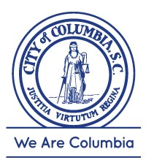
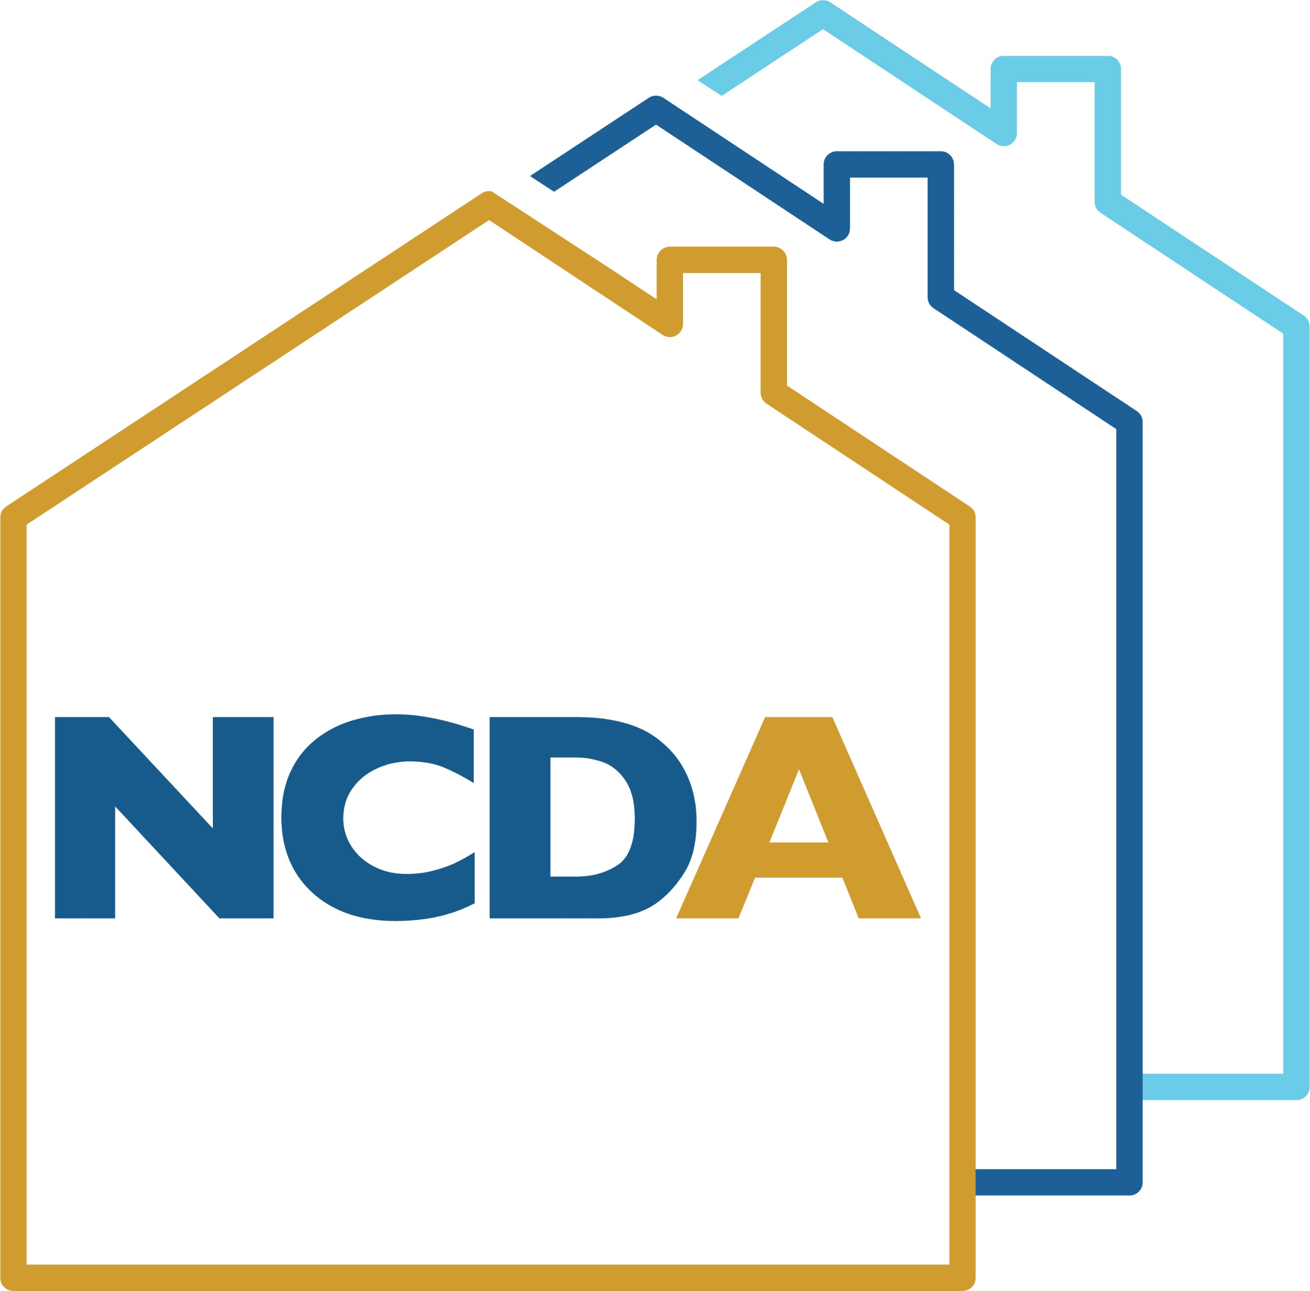
Targeting HUD Funds to Areas of Need

Slide 2
Community Development Department
Mission:
To improve the quality of life for Columbia’s citizens by providing economic, housing and social opportunities. We are the fuel supporting the local economy by providing resources and opportunities for growth. Community Development administers federal, state and local funding and ensures compliance. Community Development programs increase home-ownership and build neighborhood capacity while offering excellent customer service. Partnerships with banks, neighborhoods and organizations allow us to improve the quality of life and continue to make Columbia a world class city.

Slide 3
City of Columbia
Centrally located in the State of South Carolina.
City Hall located in Richland County and geographical incorporated city limits include portions of Lexington County.
The City’s population was 136,362 as of 2020, according to the United States Census Bureau.
The City operates under a council-manage form of government

Slide 4
Participating Jurisdiction
HUD Grantee
Annual Entitlement Allocation Recipient
Congressional Appropriations Allocation Recipient

Slide 5
FY2022 HUD Funding Allocations/Revenue
Source | Amount | Program Income/RLF | Prior Year Funding | Total Revenue
CDBG | $1,022,179 | $1,182,860 | $948.00 | $2,205,987
HOME | $773,312 | $517,000 | - | $1,290,312
HOPWA | $1,693,158 | - | - | $1,693,158
Total | $3,488,649 | $1,699,860 | $948.00 | $5,189,457

Slide 6
Other Federal Funding Sources
Source | Amount | Information
CDBG-Disaster Recovery (CDBG-DR) Program | $26,155,000 | January 2017, (Public Law 114-113) (Public Law 115-31)
CDBG-Mitigation Program (CDBG-MIT) | $18,585,000 | February 2018, (Public Law 115-123)
Federal Coronavirus Aid, Relief and Economic Security (CARES) Act CDBG-CV1 CDBG-CV3 HOPWA-CV HOME-ARP | $611,921 $976,268 $220,838 $2,500,820 | March 27, 2020 (Public Law 116-136) (Public Law 117-2)

Slide 7
5-Year Con Plan Priority Needs & Goals
Expand & Improve Public Infrastructure & Facilities | 1A Expand Public Infrastructure 1B Improve Public Infrastructure Capacity 1C Improve Access to Public Facilities
Preserve & Develop Affordable Housing | 2A Increase Homeownership Opportunities 2B Increase Affordable Rental Housing Opportunities 2C Provide Code Enforcement in LMI Neighborhoods 2D Provide Removal of Slum & Blight in Residential 2E Provide for Owner Occupied Housing Rehab
Public Services & Quality of Life Improvements | 3A Provide Supportive Services for Special Needs 3B Provide Vital Services for LMI Households
Housing & Supportive Services for Persons HIV/AIDS | 4A Provide Housing Opportunities Persons HIV/AIDS 4B Provide Medical & Support Services HIV/AIDS
Provide for Economic Opportunities | 5A. Provide financial assistance to new and expanding businesses

Slide 8
Redevelopment Areas
City Council determined Targeted Redevelopment Areas and funding to City projects to accomplish development goals.
Belvedere Neighborhood Redevelopment Area
Booker Washington Heights Redevelopment Area
Brandon Acres-Cedar Terrace Redevelopment Area
Eau Claire Redevelopment Area
Edisto Court Redevelopment Area
King/Lyon Street Redevelopment Area
Pinehurst Redevelopment Area
Over ninety-five (95%) percent of designated CDBG funds projected to assist Low-Moderate Income (LMI) persons.
70% LMI public benefit

Slide 9
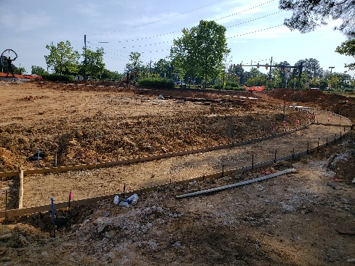
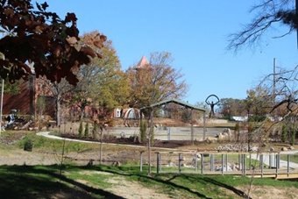
CDBG Funded Activities
Public Infrastructure & Facilities
Parks improvements
Roads and sidewalks
Lighting
Hyatt Park - CDBG - $315,000
Topic/Description - Target area is Eau Claire Neighborhood - LMA community. In 2021, the City of Columbia Parks & Recreation department received $315,000.00 in funding from the Community Development Block Grant to help implement a community driven masterplan for Hyatt Park. The funding for this park purchased a new playground, splash pad, and lighting and park gateway entries. The playground features a climbing globe, hill slides and bouldering with a seat wall located along the perimeter of the play area.

Slide 10
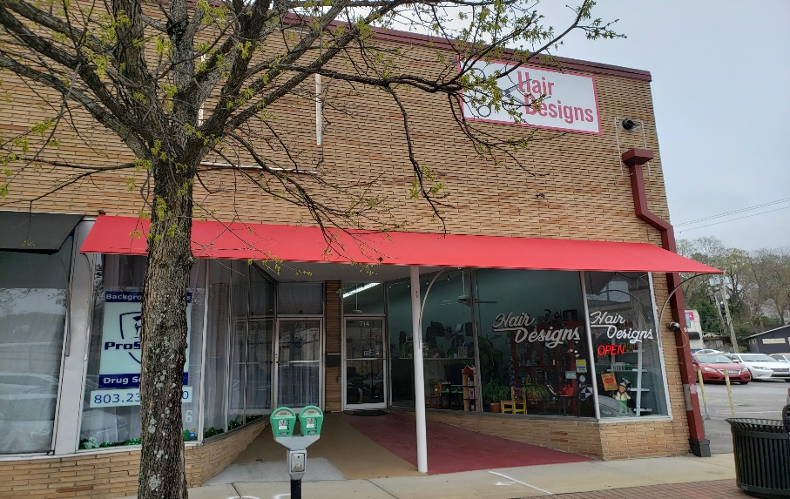
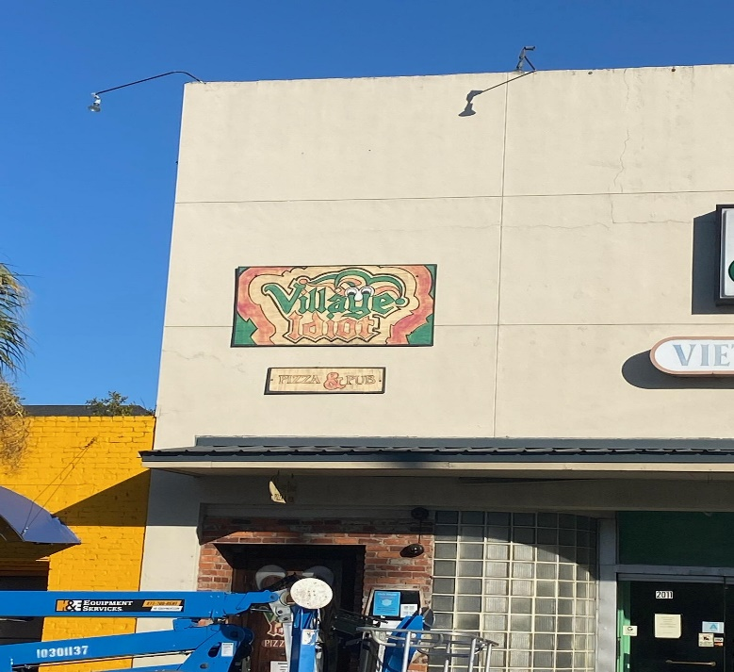
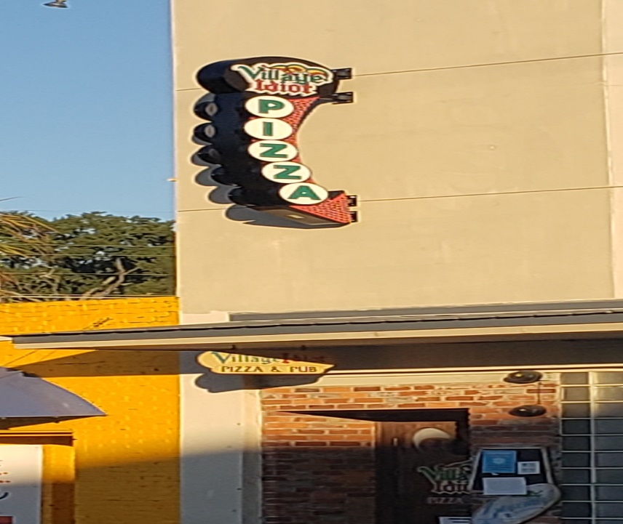
CDBG Funded Activities
Beauty Salon
Economic Development
Façade Program
Hair Design $22,625.50
Village Idiot $25,000.00
Pizza Restaurant

Slide 11
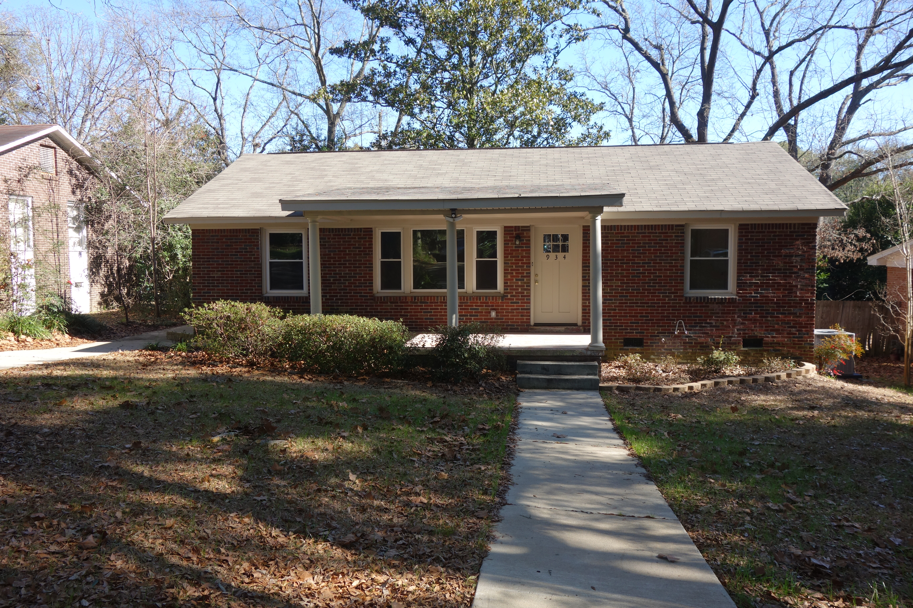
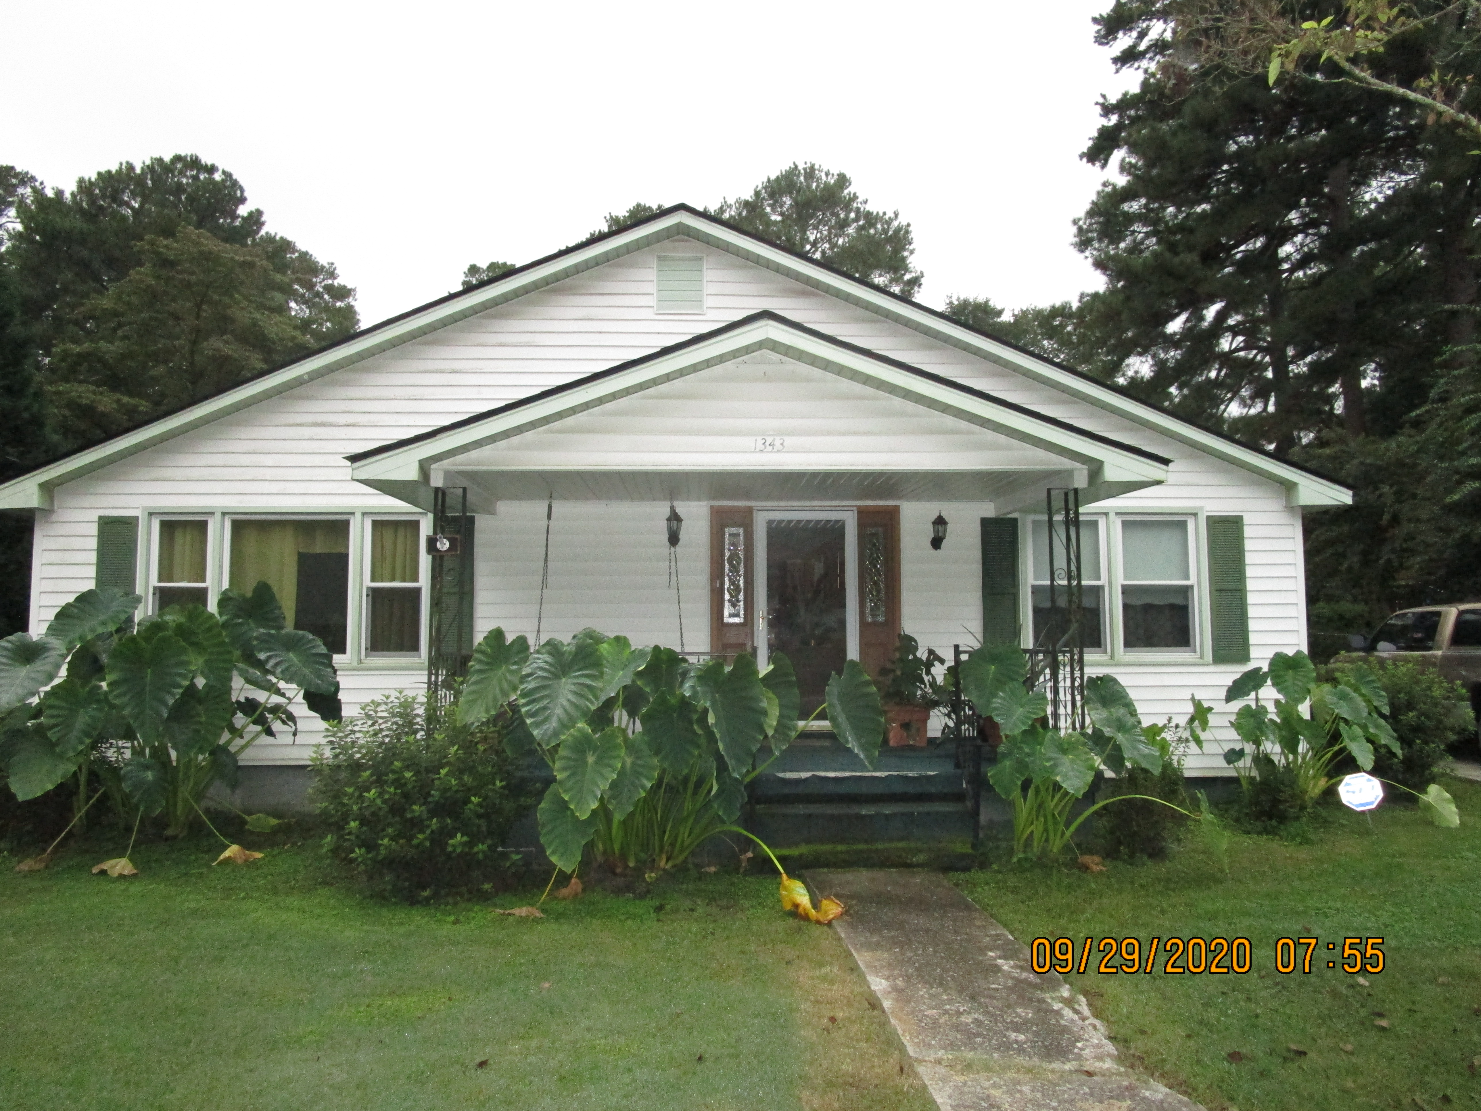
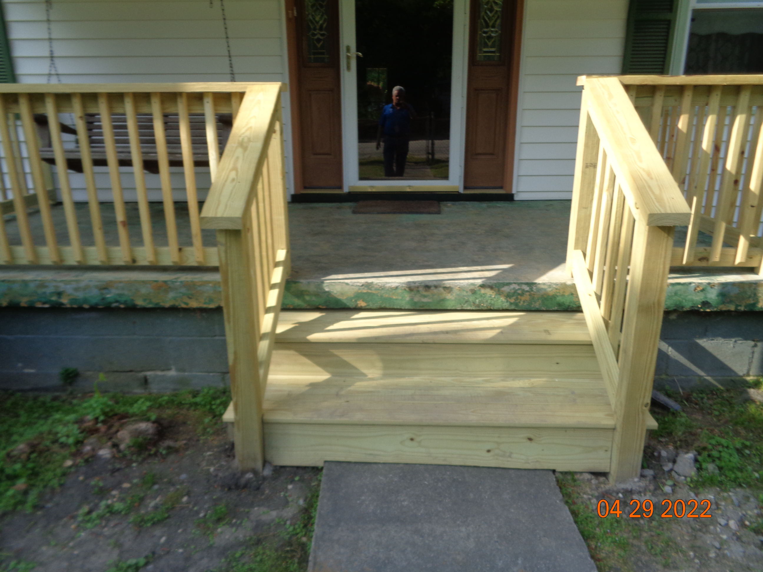
CDBG Funded Activities
HOUSING Programs
Homeownership-Affordable Home Loans/Secondary Financing/Closing Cost Assistance
Maintenance Assistance Programs (MAP)-Up to $20,000.00 grant
MAP Program
Before
Affordable Housing Loan Program
After

Slide 12
Home Investment Partnership Program (HOME)
Funds non-profit and private developers to create affordable homes for low-moderate income individuals and families (under 80% of Area Median Income).
HOME funded projects include:
Multi-family rental apartment buildings
Home Loans and Down Payment Assistance
Housing Rehabilitation
Single-Family Housing for Home Ownership

Slide 13
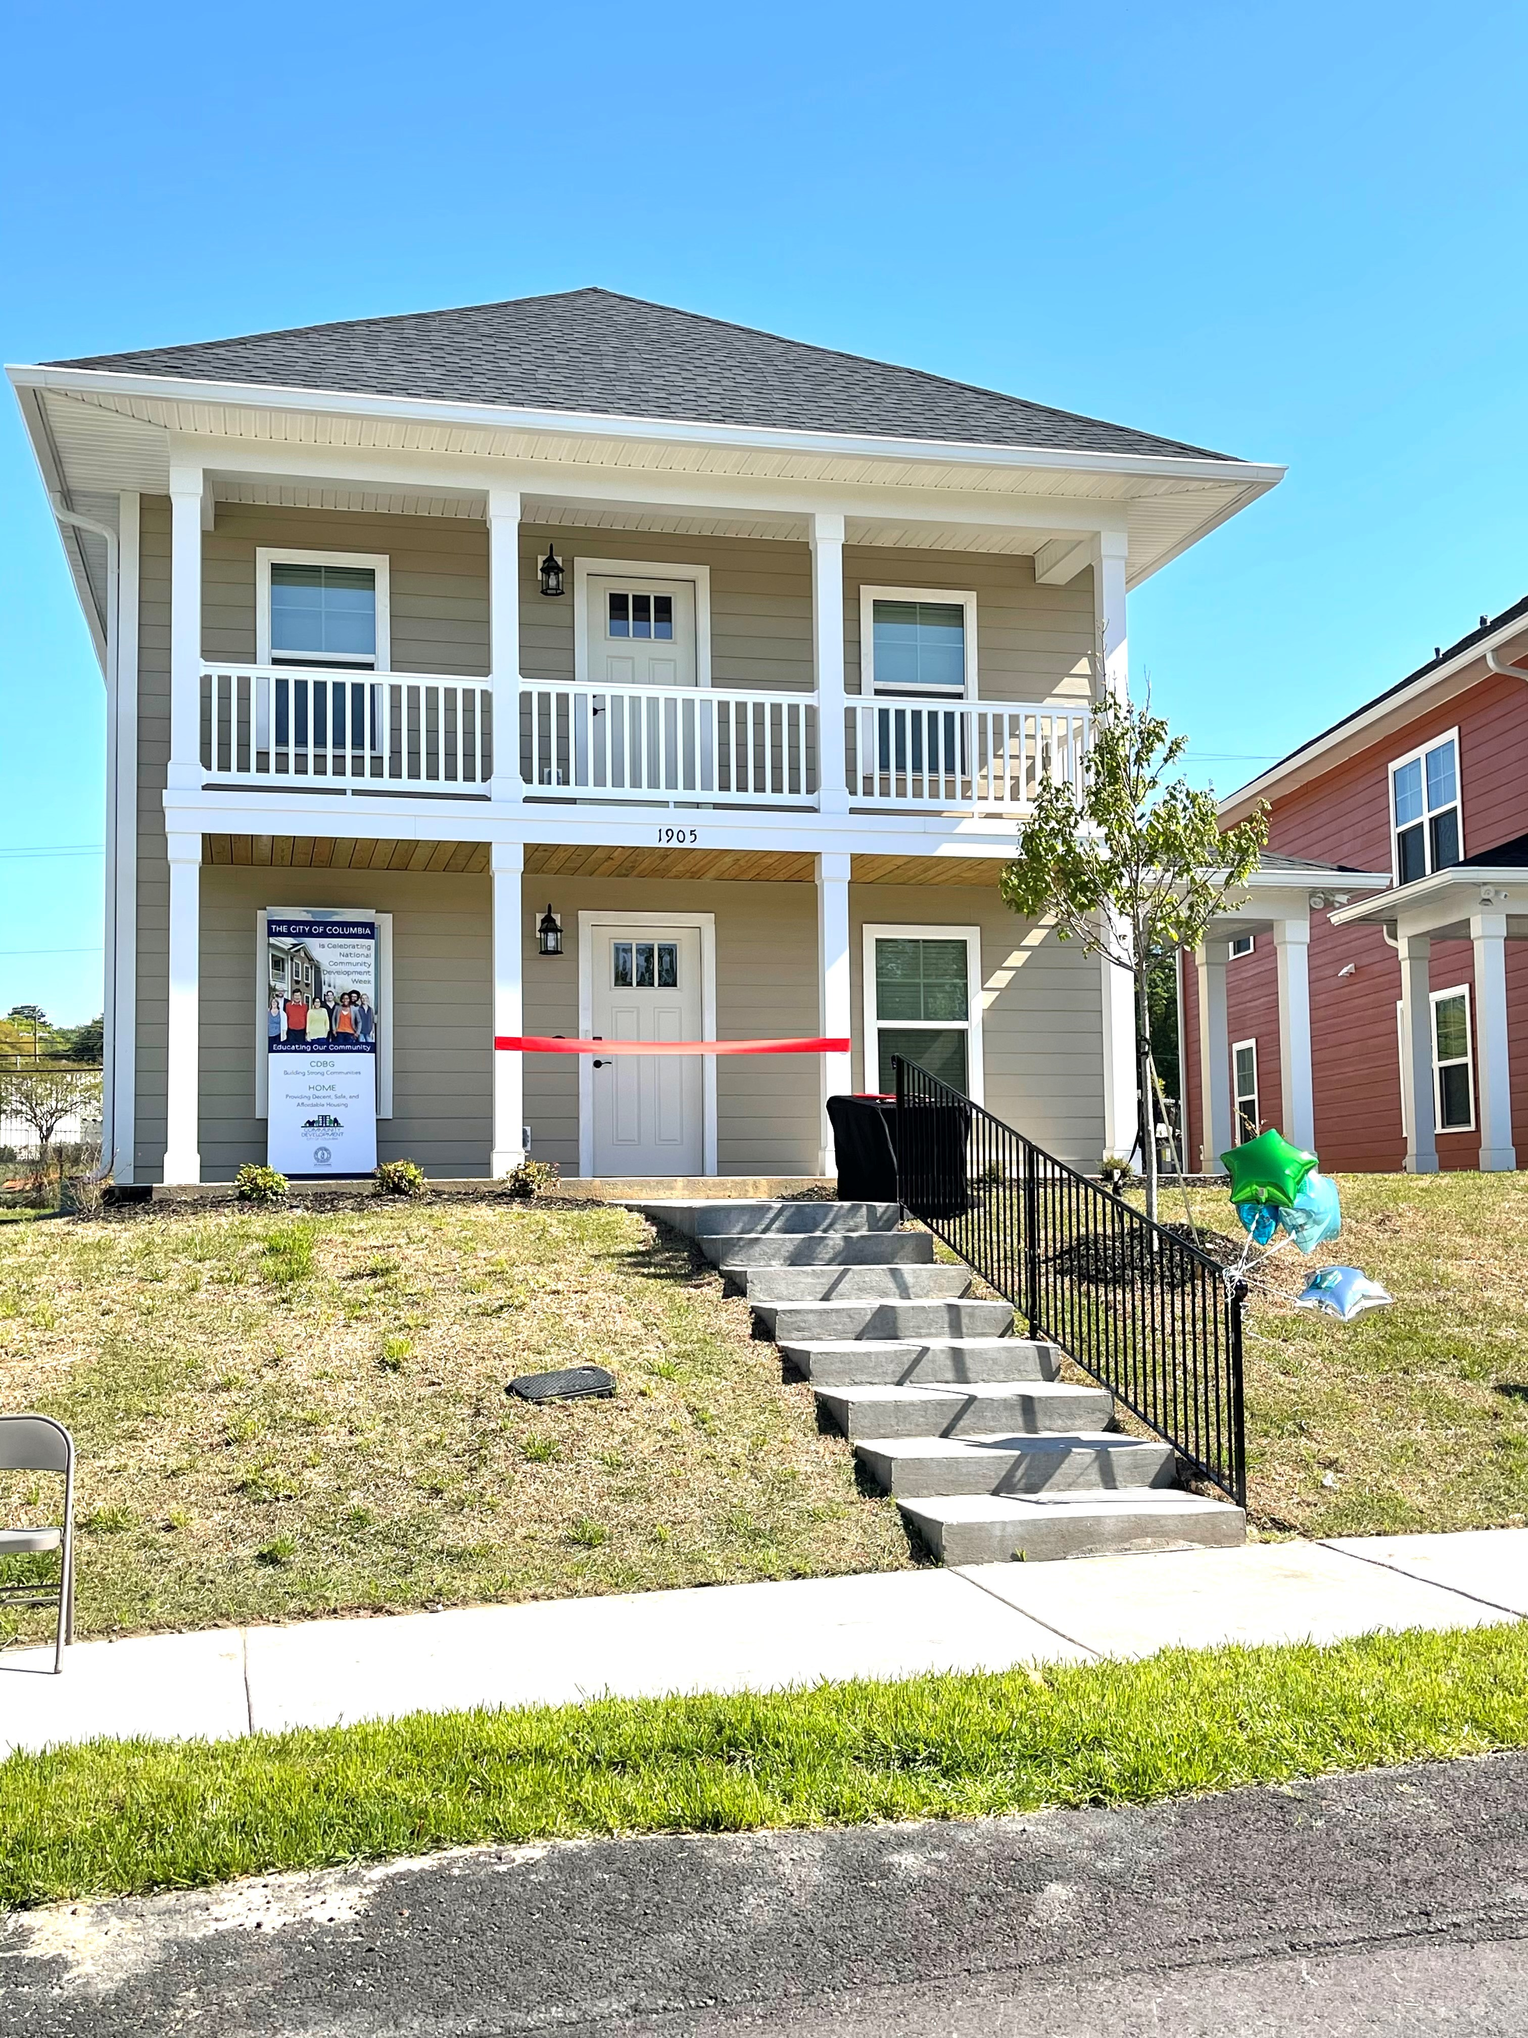
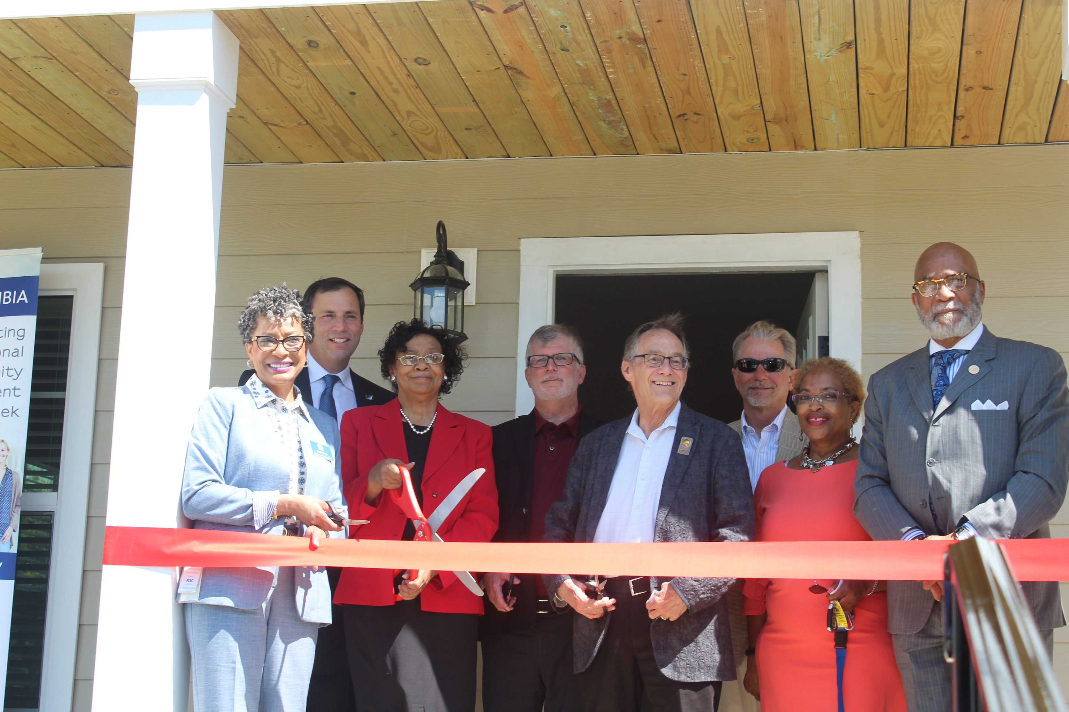
Home Funded Projects
Edisto Court – HOME $609,949.00
This multifamily affordable housing rental project consists of 29 units. The City of Columbia provided funding for 8-units including two (2) ADA accessible units totaling $609,949.00. Qualified households must be at or below 80% of HUDs Area Median Income (AMI). This new development was completed in April 2022. Edisto Place Ribbon Cutting HOME project will be part of CD Week April 11, 2022 activities.
Developer: Homes of Hope

Slide 14
THANK YOU!
City of Columbia
Community Development Department
1401 Main Street, 4th Floor
Columbia, SC 29201
CommunityDevelopment@ColumbiaSC.gov
Phone: 803-545-3373 Fax: 803-255-8912

